Slide 1
Fundamental Rules of Probability
Topic: Union, Joint, and Conditional Probability
Course: Machine Learning
Presented by: [Your Name]

Slide 2
Learning Objectives
• Understand the rules of probability: union, joint, and conditional
• Learn how to apply these rules in calculations
• Explore examples relevant to machine learning
• Understand relationships between rules and Bayes’ theorem

Slide 3
Union of Two Events
• Rule: P(A ∪ B) = P(A) + P(B) - P(A ∩ B)
• Subtracting P(A ∩ B) avoids double-counting
• If A and B are mutually exclusive: P(A ∩ B) = 0
Example:
P(A) = 0.4, P(B) = 0.3, P(A ∩ B) = 0.1
P(A ∪ B) = 0.4 + 0.3 - 0.1 = 0.6

Slide 4
Joint Probability
• Definition: Probability of both events occurring
• Rule: P(A ∩ B) = P(A) × P(B) if A and B are independent
Example:
P(A) = 0.5, P(B) = 0.4 (independent)
P(A ∩ B) = 0.5 × 0.4 = 0.2

Slide 5
Conditional Probability
• Definition: Probability of A given B has occurred
• Rule: P(A | B) = P(A ∩ B) / P(B), P(B) > 0
Example:
P(A ∩ B) = 0.15, P(B) = 0.3
P(A | B) = 0.15 / 0.3 = 0.5

Slide 6
Relationship Between Rules
• Joint Probability via Conditionals:
P(A ∩ B) = P(A | B) × P(B) = P(B | A) × P(A)
• Foundation for Bayes’ Theorem
• Essential for probabilistic ML models

Slide 7
Applications in Machine Learning
• Naive Bayes Classifier: Uses P(Class | Features)
• Bayesian Networks: Graphs of conditional dependencies
• Hidden Markov Models: Use joint & conditional probabilities
• Probabilistic Inference and Generative Models

Slide 8
Summary
• Union Rule: P(A ∪ B) = P(A) + P(B) - P(A ∩ B)
• Joint Rule: P(A ∩ B) = P(A) × P(B) for independent A, B
• Conditional: P(A | B) = P(A ∩ B) / P(B)
• These rules underpin many machine learning models

Slide 9
Bayes’ Rule – Applications in Machine Learning
Example: Medical Diagnosis and Generative Classifiers
Course: Machine Learning
Instructor: [Your Name]
Notes:
Introduce Bayes' Rule and its relevance in machine learning through practical applications: medical diagnosis and generative classifiers.

Slide 10
What is Bayes’ Rule?
P(A|B) = [P(B|A) * P(A)] / P(B)
Used to update beliefs after observing evidence.
Posterior = Likelihood × Prior / Evidence
Notes:
Explain the formula and emphasize that Bayes' Rule allows updating prior beliefs based on new data.

Slide 11
Components of Bayes’ Rule
P(A): Prior probability (before seeing evidence)
P(B|A): Likelihood (probability of evidence given A)
P(B): Marginal Probability of evidence
P(A|B): Posterior (updated probability of A given B)
Notes:
Break down each component and relate it to real-world terminology and understanding.

Slide 12
Example – Medical Diagnosis Problem
A disease affects 1% of the population. A diagnostic test gives a positive result 99% of the time if the patient has the disease and gives a false positive 5% of the time.
Disease prevalence = 1%
True Positive Rate = 99%
False Positive Rate = 5%
Notes:
Pose a real-world problem: interpreting a medical test result using Bayesian reasoning.

Slide 13
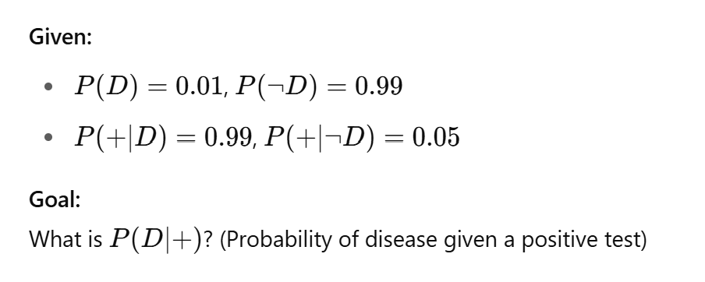
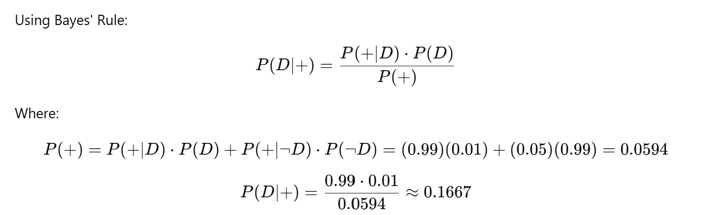
Solution – Medical Diagnosis
Only ~16.67% of positive tests actually indicate disease due to low base rate (prior).
Notes:
Walk through the calculation step-by-step and highlight the importance of the base rate.

Slide 14
Why It Matters – Real-World Relevance
High accuracy does not guarantee high certainty in results
Bayesian inference corrects for base rate fallacy
Helps avoid overconfidence in model predictions
Notes:
Use this to illustrate the 'base rate fallacy' and show why Bayesian methods are crucial.

Slide 15
Example – Generative Classifiers (Naive Bayes)
Bayes’ Rule is used in Naive Bayes Classifiers
Goal: Predict class C given features x₁,x₂,...,x_{n}​
Naive Bayes uses Bayes’ Rule:
P(C|x) = P(x|C) * P(C) / P(x)
Notes:
Introduce how Naive Bayes classifiers work based on Bayes' theorem.

Slide 16
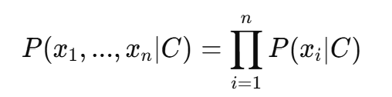
Assumptions in Naive Bayes
Assumes conditional independence:
This simplifies computation significantly
Notes:
Clarify the conditional independence assumption and its implications for scalability.

Slide 17
Naive Bayes Classifier Workflow
1. Calculate prior probabilities P(C)
2. Estimate likelihood P(x_{i}∣C) from training data
3. Use Bayes’ Rule to get posterior P(C∣x₁,...,x_{n})
4. Choose class with max posterior
Notes:
Detail the steps in applying a Naive Bayes model to data.

Slide 18
Example – Text Classification
Spam detection using word features and Bayes' Rule
Classes: Spam / Not Spam
Features: Word counts or word presence (e.g., “free”, “offer”)
Naive Bayes predicts spam based on word likelihoods:
P(Spam∣free, win)∝P(free∣Spam)⋅P(win∣Spam)⋅P(Spam)
Notes:
Demonstrate Naive Bayes in action with a practical NLP task like spam classification.

Slide 19
Summary
Bayes' Rule = Prior × Likelihood / Evidence
Used in inference and classification
Notes:
Recap core takeaways: Bayesian inference, model design, Naive Bayes usage.

Slide 20
Suggested Practice
Try problems on medical diagnosis
Implement Naive Bayes in scikit-learn
Compare with Logistic Regression
Notes:
Encourage hands-on exercises and comparisons with other models.

